Slide 1

The Risk Management of Tactical Cyber Threats in Australian Army Operations
David Ormrod
UNSW PhD Candidate
Supervisor: Dr Edward Lewis
UNSW Co-Supervisor: Dr Spike Barlow
DSTO Co-Supervisor: Dr Fred Bowden

Slide 2
Cyber threats and Army operations
Management of uncertainty in combat
Advantages of network-enabled combat force
Attacking the network
Deception
Targeting trust
Research methodology
Implications for wargaming

Slide 3
Decision making in combat is about managing uncertainty (risk)
Uncertainty
Precision
Ambiguity
Friction
High levels of risk
Redundancy
Sensor to shooter links
Interconnected systems
Network Centric Warfare
Full Spectrum Operations
Common Operating Picture
“…a far smaller, lighter and more mobile force can operate at a greater range and with higher precision than at any time in human history”.
Source: Adamsky, 2010

Slide 4
History demonstrates the advantage of network enabled combat
Historical Examples
The German Army of World War Two – analog network, appropriately equipped and trained personnel
Stryker Brigade - digitized network with documented benefits in comparison to the standard light infantry unit
US ‘Thunder Runs’ on Iraqi defenses in Operation Iraqi Freedom - networked Blue Force Tracking (BFT) systems

Slide 5
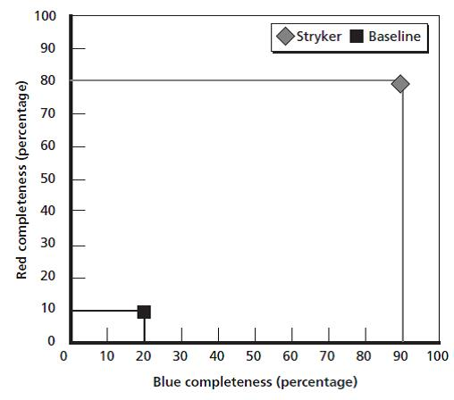
Benefits of network enabled land combat forces (as an integrated package)
Enhanced situational awareness
Network enabled awareness
Source: Gonzales, 2005

Slide 6
A near peer adversary will also seek to obtain information dominance
“The Armed Forces [are] now so dependent on information and communications technology, should such systems suffer a sustained cyber attack, their ability to operate could be fatally compromised”.
Source: UK Ministry of Defence, 2013
“…the underlying infrastructure becomes a single point of failure. It is thus likely that the enemy of a networked force will target the underlying technology by conducting information warfare, net warfare or communication infrastructure warfare”
Source: Aho and Candolin 2004 p10

Slide 7
History demonstrates the advantage of attacking the network
Historical Examples
The German Navy of World War Two – Admiral Donitz.
Enigma, Ultra and Bletchley Park.
The alignment of virtual data to reality:
  USS Vincennes - Iran Civilian Aircraft 1988; and
  Patriot Missile System - RAF Tornado 2003.
Stuxnet – Attack on Iranian nuclear program. Centrifuges and C2 attacked.
Cyber Electro Magnetic Operations (US Doctrine)

Slide 8
Incorrect information creates uncertainty or validates invalid theories
Manipulating communication channels, misdirecting strategic or tactical action and confusing an opposing force’s SA.
Ambiguity – Increased noise.
Misleading – Reduced noise, wrong alternative
Neutralization - compromising the trust of the user.
Capitalization - retaining the trust of the user, whilst manipulating information to have them act against their own interests.
Deception
Network-enabled deception is a theatrical production, combining data in a complimentary way to produce a coherent and coordinated storyline of misinformation.
Trust is critical to the analysis of information in complex systems and the management of risk.
Deception
Planning
Deception
Execution

Slide 9
Information security models do not consider the commander’s perspective
The difference between the potential tactical results, with and without the cyber attack, is the true operational effect.
This is difficult to quantify because of the large number of variables inherent in both decision making and tactical combat.
Mission impact, as a third order effect, is not network denial of service or compromised data.

Slide 10
The target of a cyber attack should be the human interface
Offensive Cyber Operations
Benefits
Deny an adversary’s use or access to information, thereby impacting their decision making process.
Source: United States Army FM3-38
Malware signatures can trigger intrusion detection systems, in itself reducing trust.
“The benefits to an attacker using cyber exploits are potentially spectacular… Military Commanders may rapidly lose trust in the information… Once lost, that trust is very difficult to regain”.
Source: Defense Science Board, 2013

Slide 11
Contributions to Knowledge
Provide a method for measuring the effect of a successful C4ISR information attack on tactical land combat objectives in order to determine the best response to its risks; and
Defining the role of resilience on military tactical decision environments despite the growing dependence on technology in command and control.

Slide 12
Research Questions
Q1
What contribution does information deception make to tactical military operations when it forms part of an integrated deception plan?
Q2
What effect can a successful information attack have on tactical combat outcomes?
Q3
How does a tactical combat decision maker manage the risks associated with an information attack on their C4ISR system?
Q4
What role does resilience play in the military tactical decision environment?

Slide 13
Hypothesis for Q2
Q2: What effect can a successful information attack have on tactical combat outcomes?
  H1 Alternative: A successful information attack on a C4ISR system has a negative effect on the victim’s tactical combat capability (BattleGroup level).
    Increased casualties, increased duration (time), increased resources expended and decreased situational awareness.
  H0 Null: A successful information attack on a C4ISR system has no effect on tactical combat capability (BattleGroup level).

Slide 14
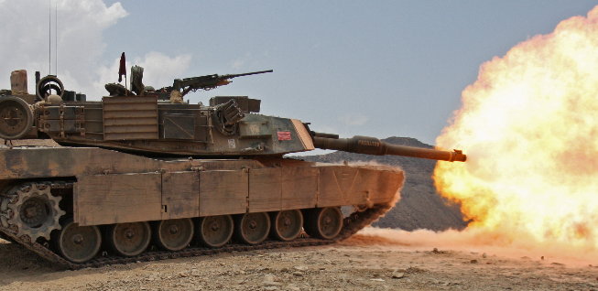

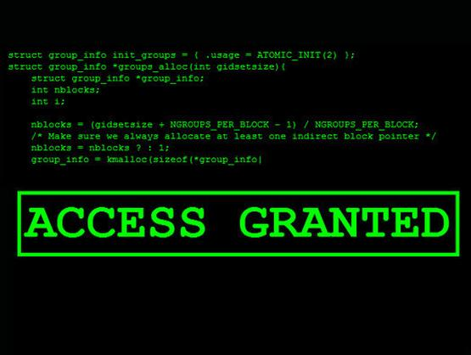
Observing the relationship between effects
  Block
  Breach
  Clear
  Destroy
Battlefield
(Kinetic System)
  Deceive
  Distract
  Deny SA
  Reduce trust
Situational Awareness
(Temporal and Cultural
Systems)
  Intrusion
  Destruction
  Collection
  Compromise
Data and Information
(Cyber Electro Magnetic
Operations)
Notes:
For example, distrust in the security of Enigma was reportedly linked to the Director-General of Signals for the Luftwaffe in WWII refusing to send operational orders by radio
(Ratcliff, 2006).

Slide 15
Research Method
Quantitative dominant mixed methods research approach.
Triangulation.
Experimentation campaign - Sequential triangulation
  Phase 1. Literature review.
  Phase 2. Historical analysis.
  Phase 3. Semi structured interviews (approx 60 Army officers).
  Phase 4. Model development.
  Phase 5. Cyber range – representation of communications and cyber model.
  Phase 6. Combat simulation 1 - Constructive, closed.
  Phase 7. Combat simulation 2 - Human-in-the-loop.

Slide 16
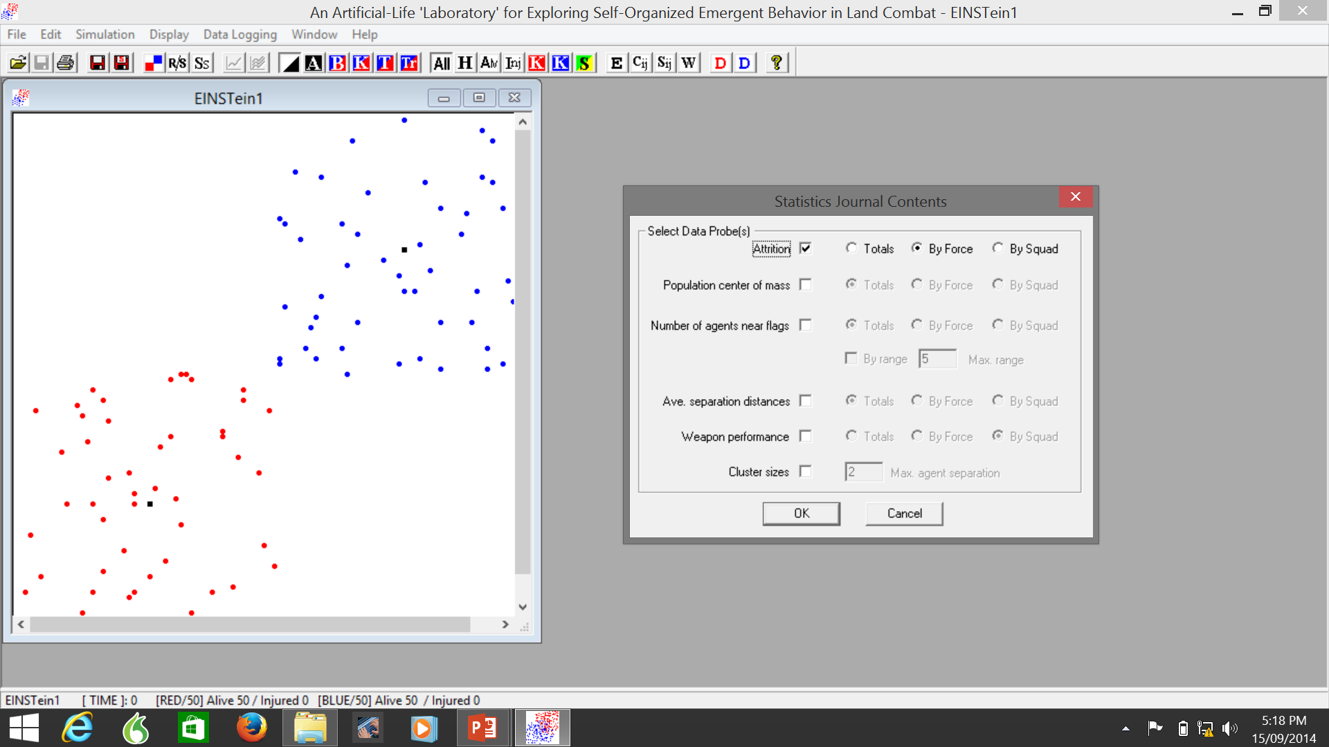
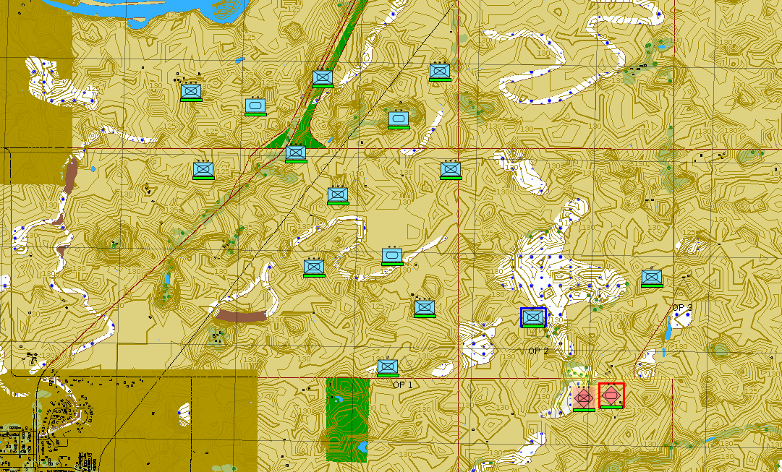
Proposed Simulation Toolset
Closed Loop
EINSTein/CROCADILE/MANA:
  Multi-agent combat simulation
  Self organised emergent behaviour
  Programmable agent behaviours
Human in the Loop
OneSAF/JCATS or VBS3:
  US Army entity level land combat simulation – may include visualisation
  Higher fidelity but requires command input (human)

Slide 17
Cyber Range
Representation of:
  Virtual environment;
  Data packets;
  Communication nodes.
Allows:
  Injection of malicious files;
  Disruption of data;
  Attacks on specific nodes.
Comparison of data, information and decisions.
Is this wargaming?

Slide 18
Combat Simulation 1 – Closed loop
Closed loop simulation – multiple runs.
Complex adaptive system – explore scenarios (less realistic).
Feeds the human-in-the-loop simulation.
Identify key variables for analysis:
  Effect of terrain;
  Effect of mission – attack, defence, mobile, static.
  Effect of trust and SOPs;
  Value of differing communication channels;
  Value of specific sets of information;
  Value of specific nodes – recon/OP/retrains/logistics/CP;
  Integration of OCO and integrated deception plans.
Is this wargaming?

Slide 19
Combat Simulation 2 – Human in the loop
Options:
  Simple simulation – VBS3 allows CNR Sim and Visualisation.
  Focus on human decision making - JCATS and OneSAF.
  Experimentation tools – Combat XXI (issues with human in the loop).
Differing simulation runs – as an example:
  C4ISR is not compromised.
  C4ISR is compromised, no deception (compromised confidentiality).
  C4ISR is compromised and deception occurs (compromised integrity).
  C4ISR is compromised and denial of service occurs (compromised availability).
Modelling of the enemy:
  live human;
  decision points set by human; or
  scripted AI.
Is this wargaming?

Slide 20
Implications for Wargaming
Relevant:
  Terrain (desert vs complex environment).
  Decision making (the human interface).
  Tactical effect (defend vs attack).
  Practical – the human interface with the machine.
Repeatable:
  Focus on small and well defined aspects of the problem.
  Simulation – scenario based, red teamed (AI).
  Selection of the best simulation approach.

Slide 21
Architecture and Models

Slide 22
The type of network and its information sharing features

Slide 23
Measuring Effect
Mission Success
  Primary Objective
  Secondary Objective
Casualties
Combat Power
Ability to hold objective
Ability to conduct subsequent operations

Slide 24
Existing Cyber Simulation in a ‘Wargame’

Slide 25
Next Steps
Semi Structured Interviews complete.
Model development ongoing – artefact expected late 2015.
Thesis submission planned for mid 2016.

Slide 26
Questions?

